Slide 1
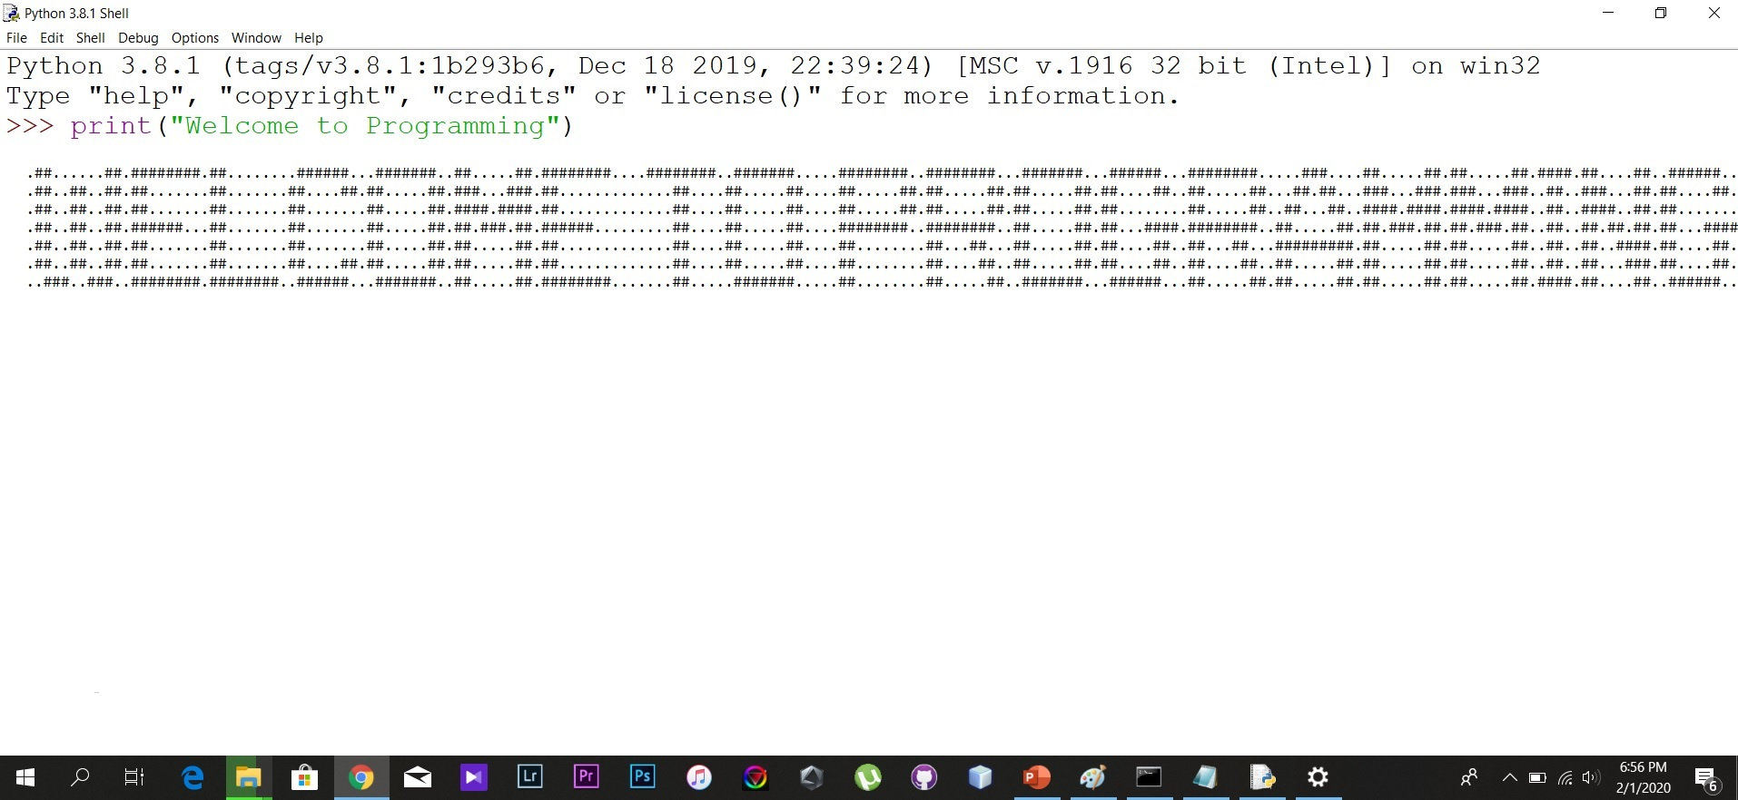
Start
Print “Welcome to Programming”
End

